Slide 1
Build a Watson AI Chatbot from Db2
Sanjula Ganepola
Software Developer
sanjula.ganepola@ibm.com

Slide 2
Agenda
Overview of Watsonx Assistant
Planning Your Assistant
Terminology You Should Know
Let’s Build a Chatbot
Refine Your Assistant
Integrate with Watsonx Discovery
Integrate with Db2

Slide 3
Overview of Watsonx Assistant

Slide 4
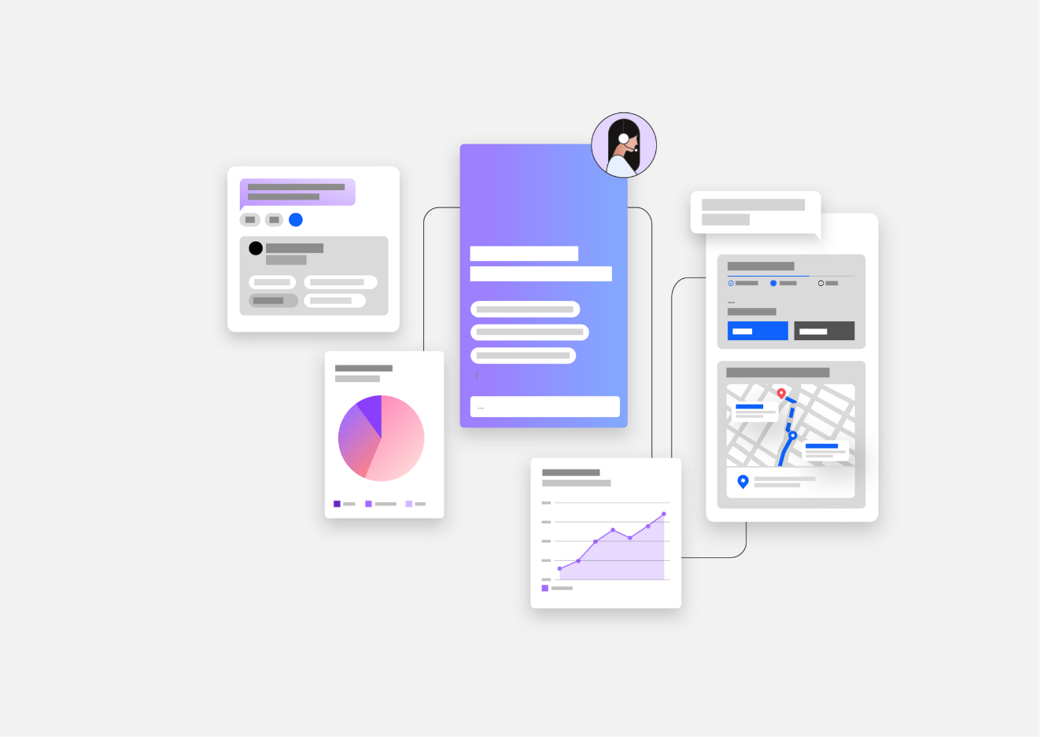
What is Watsonx Assistant?
“Conversational AI solution that empowers anyone to effortlessly build generative AI Assistants that deliver frictionless self-service experiences to customers”
↓
Use Watsonx Assistant to build your own branded live chatbot
💻 Bring the assistant to your customers, where they are
🧠 Create AI-driven conversational flows
📑 Embed existing help content
🤝 Connect to your customer service teams
🎯 Track customer engagement and satisfaction

Slide 5
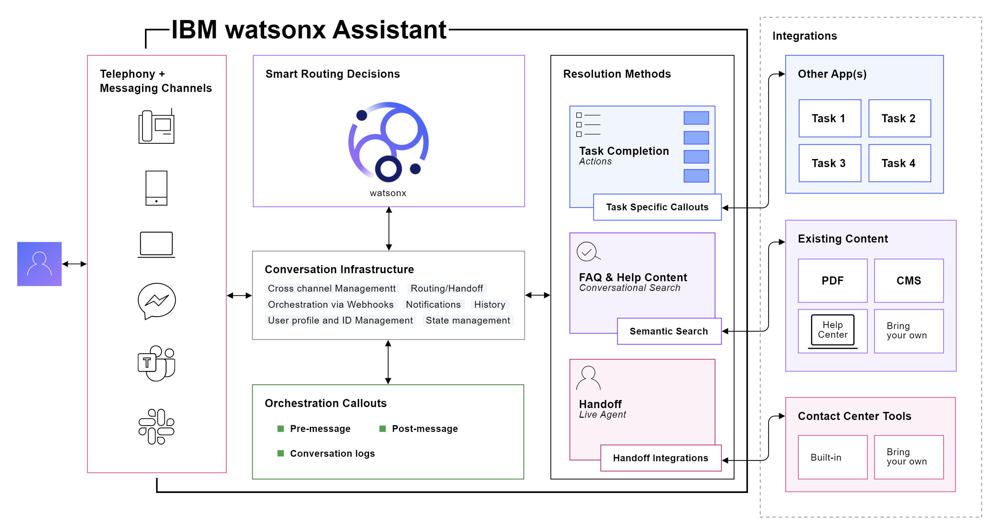
How Does It Work?

Slide 6
Planning Your Assistant

Slide 7
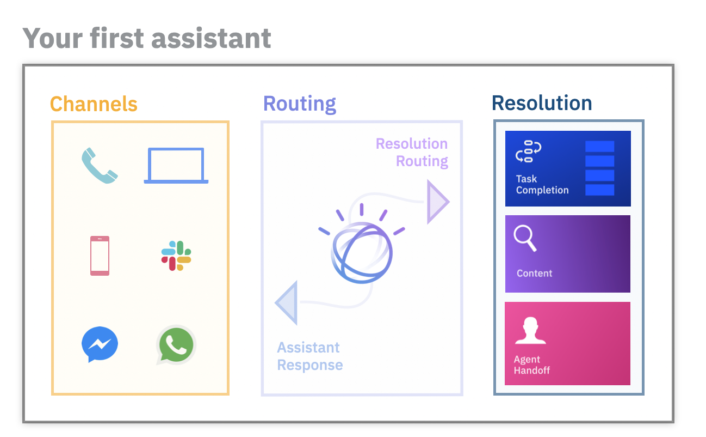
Before building an assistant…
Select an initial channel
Where will customers use your assistant?
Select starting domain
What topic domain can your assistant unify and automate?
Outline frequent topics
What are the most frequent topics which are mostly informational in nature?
Collect content sources
What help content is available to customers today?
Plan handoff strategy
How should customers be routed to human agents?

Slide 8




Demo Example – ConnectMe Inc.
ConnectMe Inc. is a telecommunications company with cable, internet, and phone services
Goals
Automate bill payments services
Update customer data in real-time
Provide 24/7 support
Improve accessibility of FAQ manuals
Plan
Select an initial channel
Easy-to-embed web chat widget
Select starting domain
ADD TEXT HERE
Outline frequent topics
ADD TEXT HERE
Collect content sources
ADD TEXT HERE
Plan handoff strategy
ADD TEXT HERE
ConnectMe Inc.
Customer A
Support Rep A
Database
Customer B
Support Rep B
FAQ Manual

Slide 9
Terminology You Should Know

Slide 10
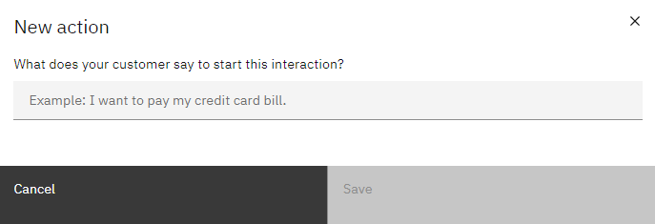
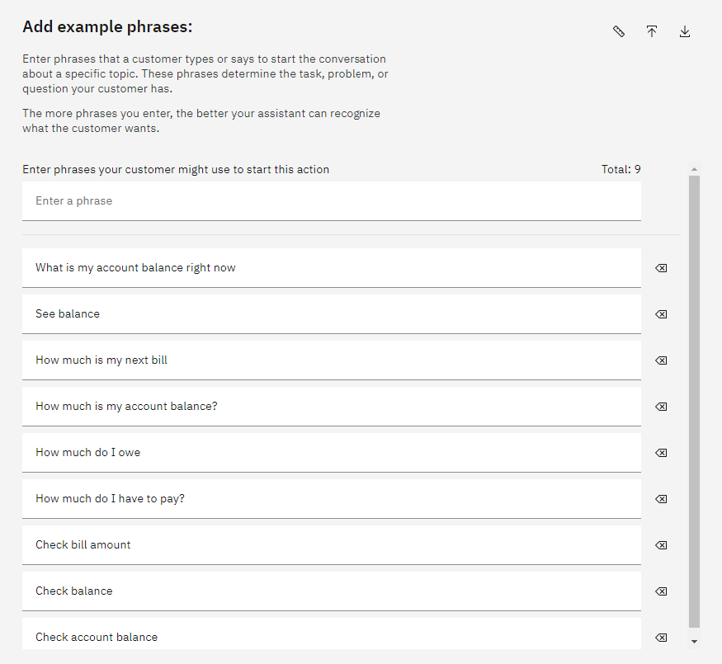
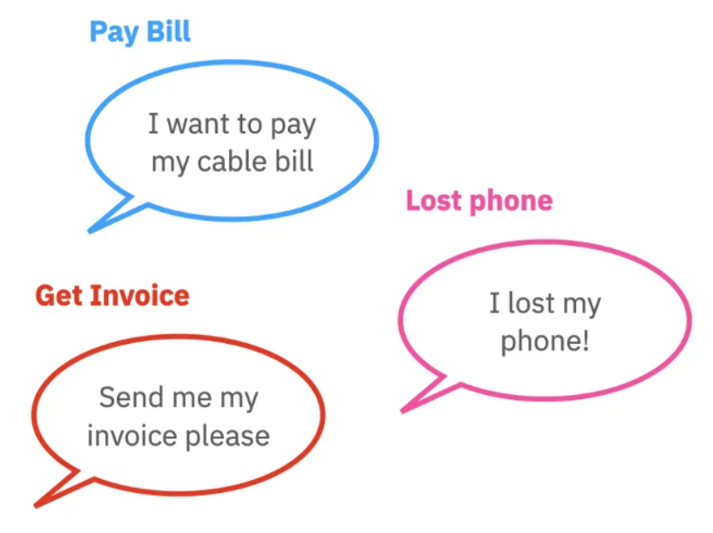
What are Actions and Phrases?
An action is a problem or a task that your customer wants to resolve
Phrases are what customers type or say to start an action
Add multiple phrases to better train your assistant to recognize what customers want

Slide 11
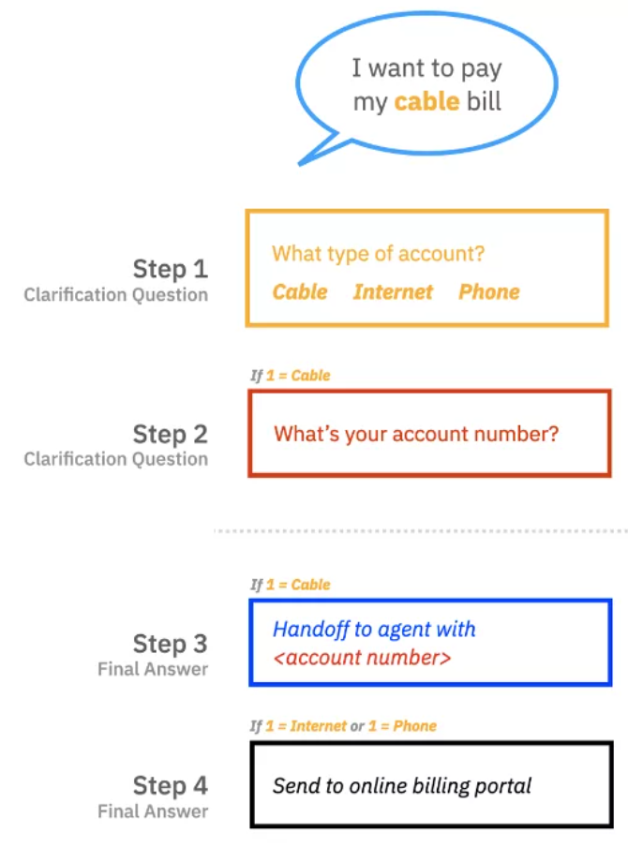
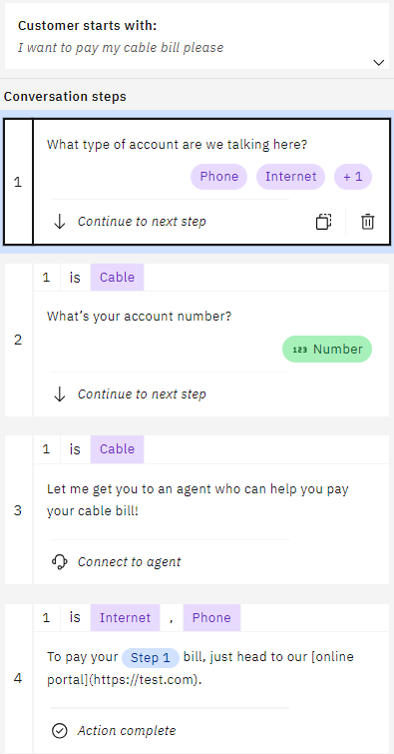
What are Steps and Conditions?
A step is a back-and-forth interaction between your assistant and your customer
Conditions are requirements which must be met for the step to be triggered

Slide 12
Let’s Build a Chatbot

Slide 13
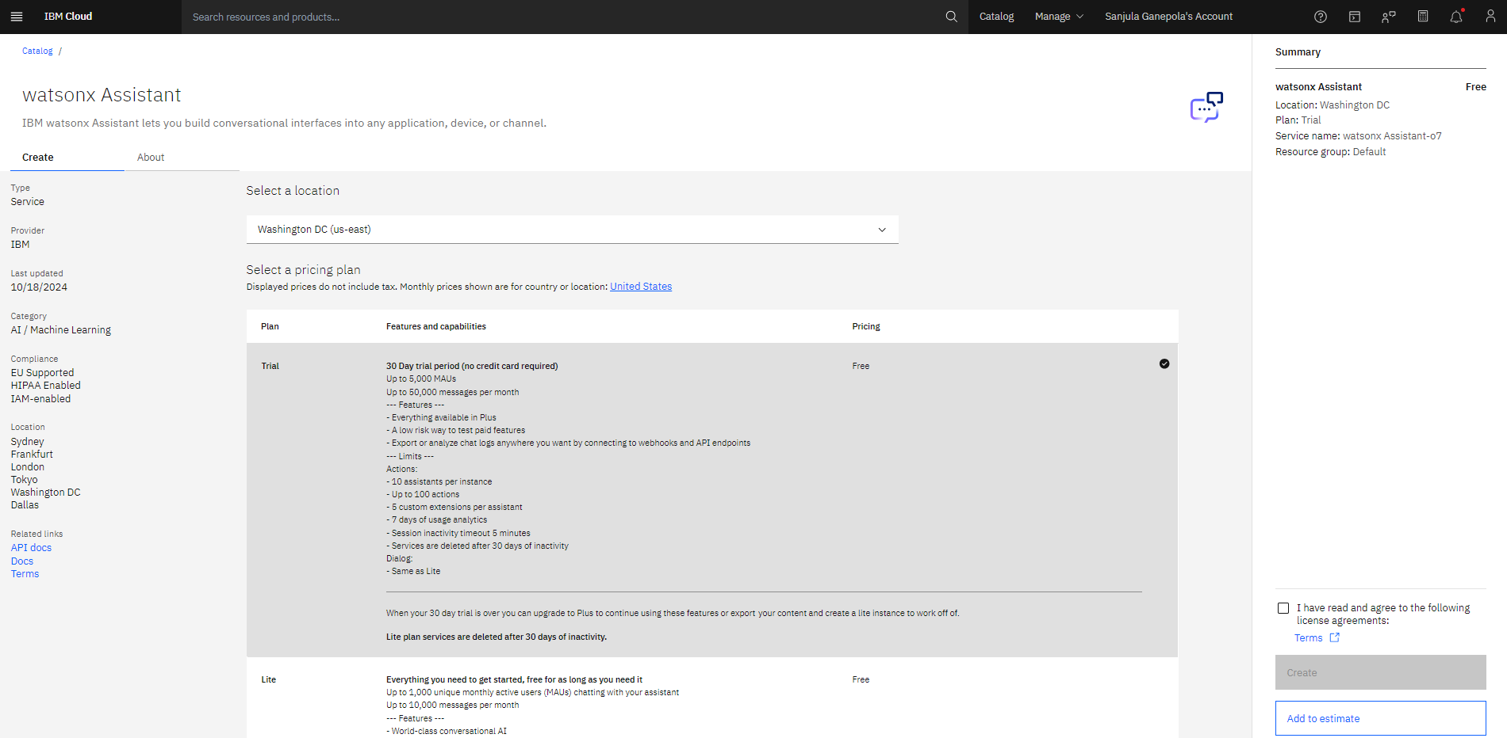
Create Watsonx Assistant Instance

Slide 14
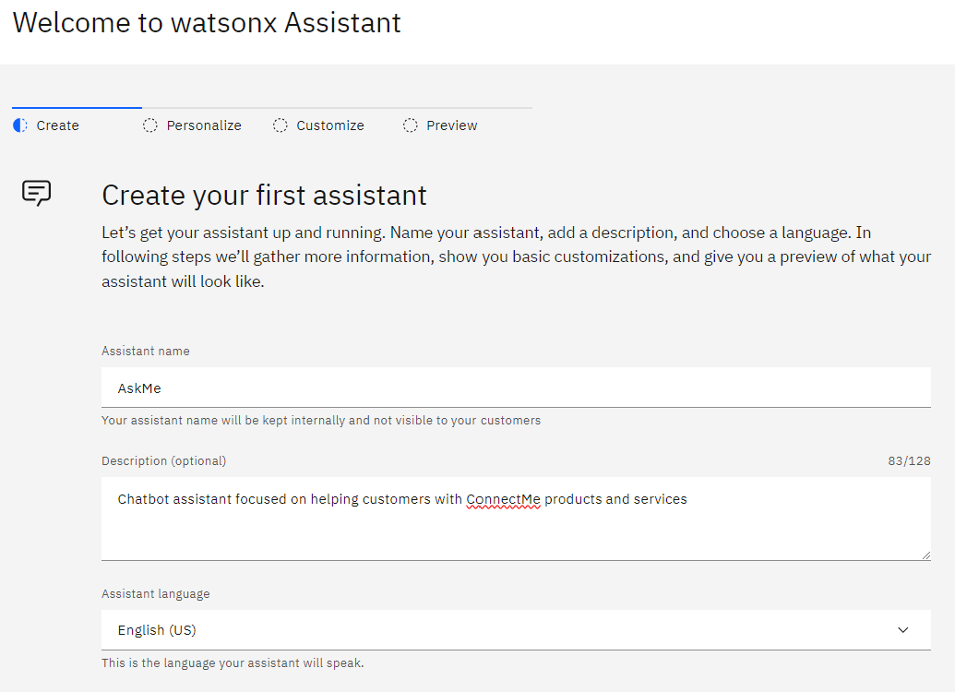
Create Watsonx Assistant

Slide 15
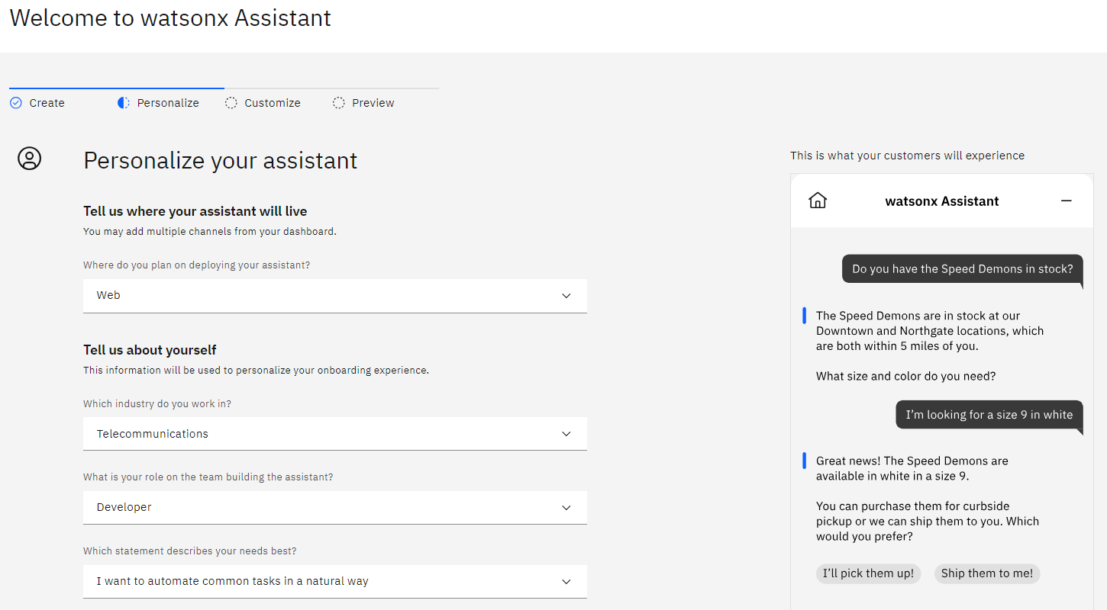
Personalize Your Assistant

Slide 16
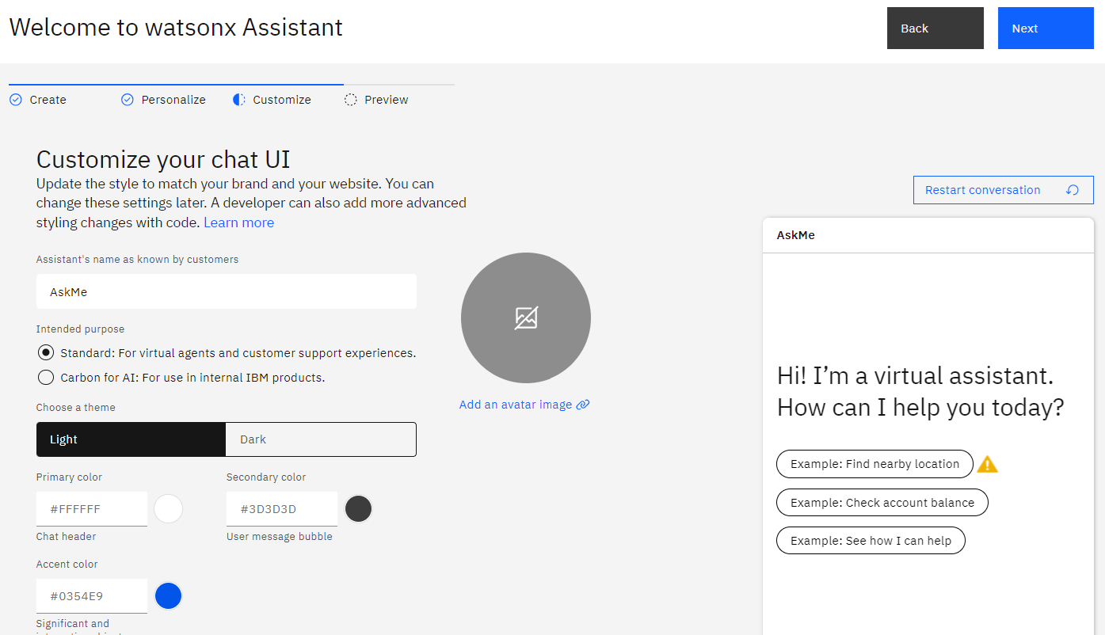
Customize Your Chat UI

Slide 17
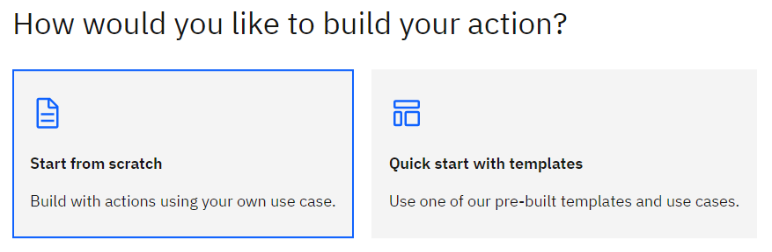
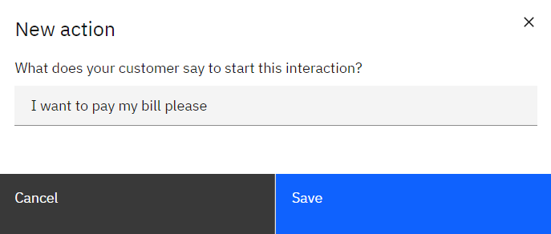
Create Action From Scratch and Set Initial Phrase
1
2

Slide 18
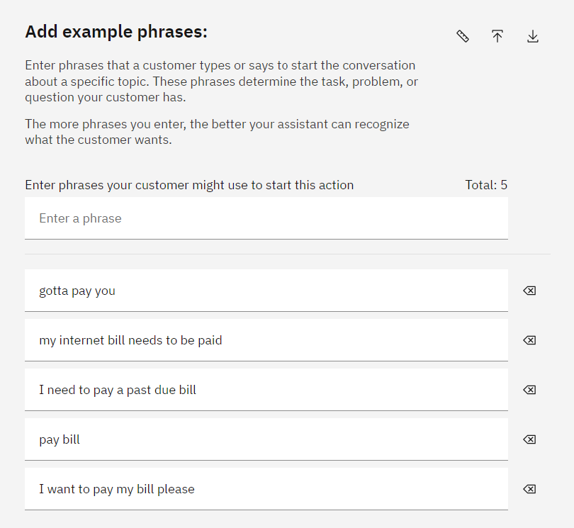
Add More Example Phrases
⭐
3

Slide 19
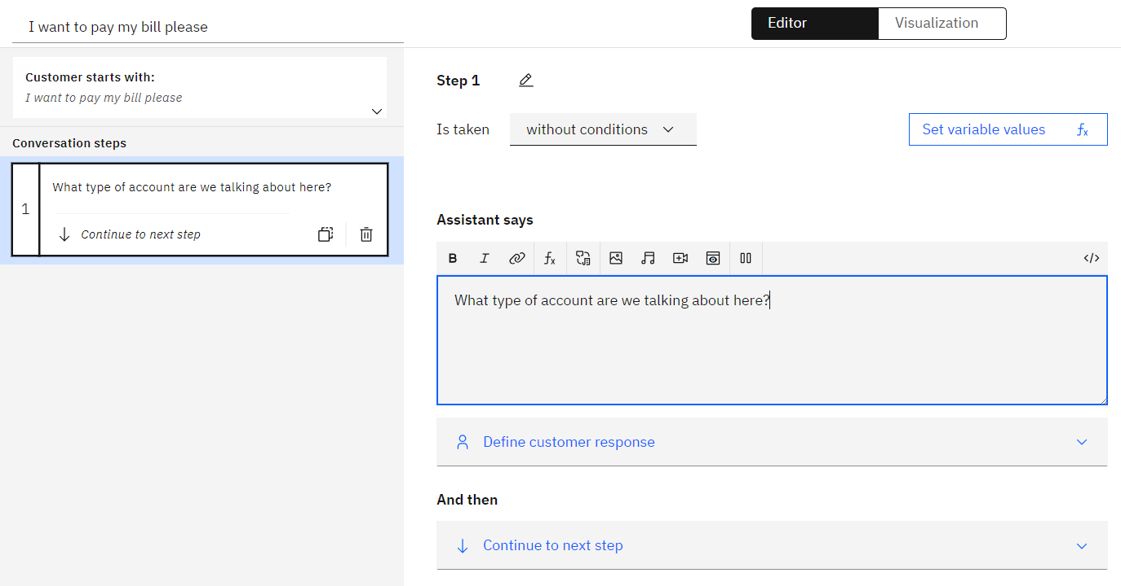
Create First Step
4

Slide 20
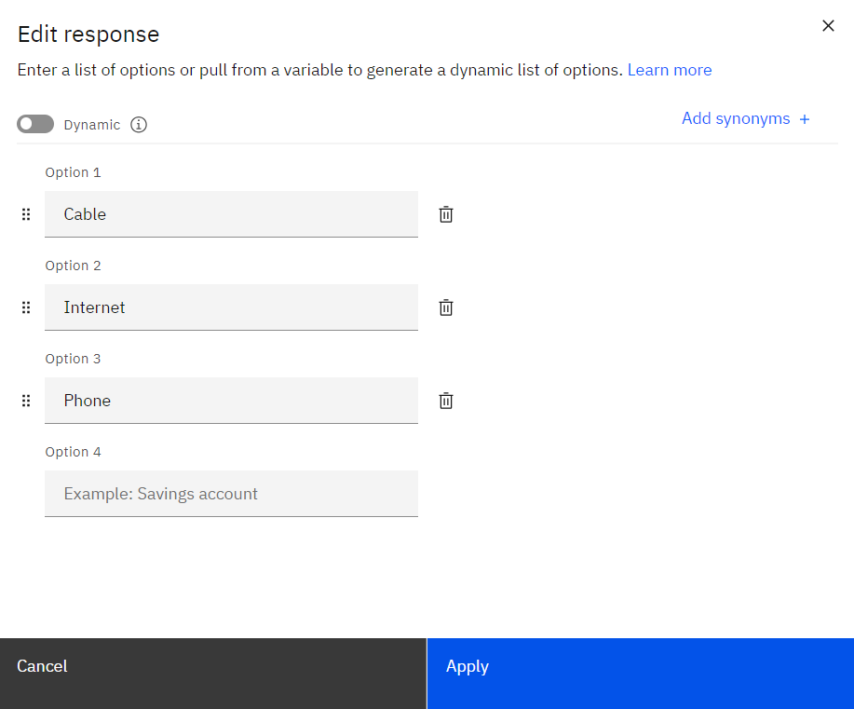
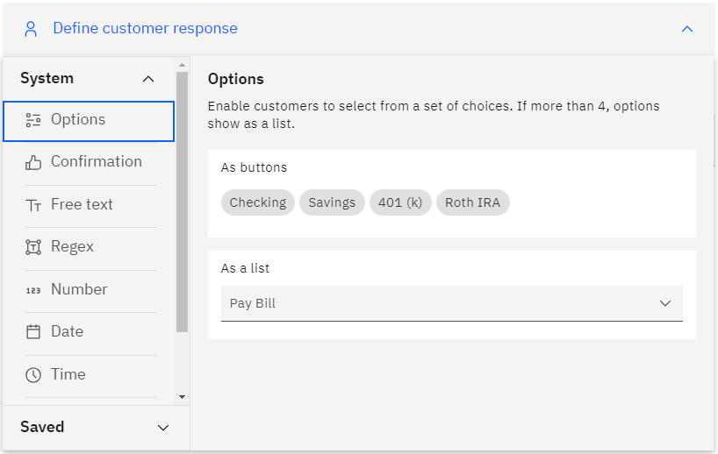
Add Custom Response Options
6
5

Slide 21
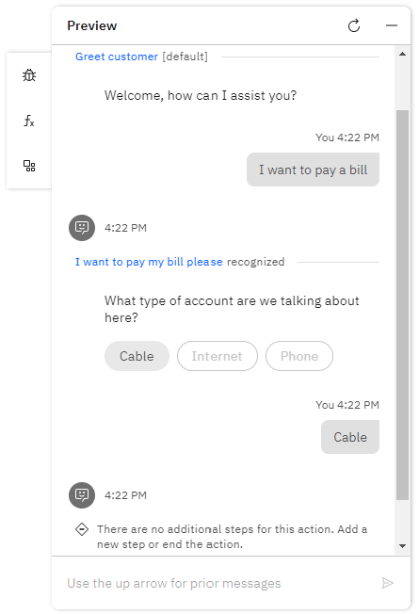
Preview Your Action

Slide 22
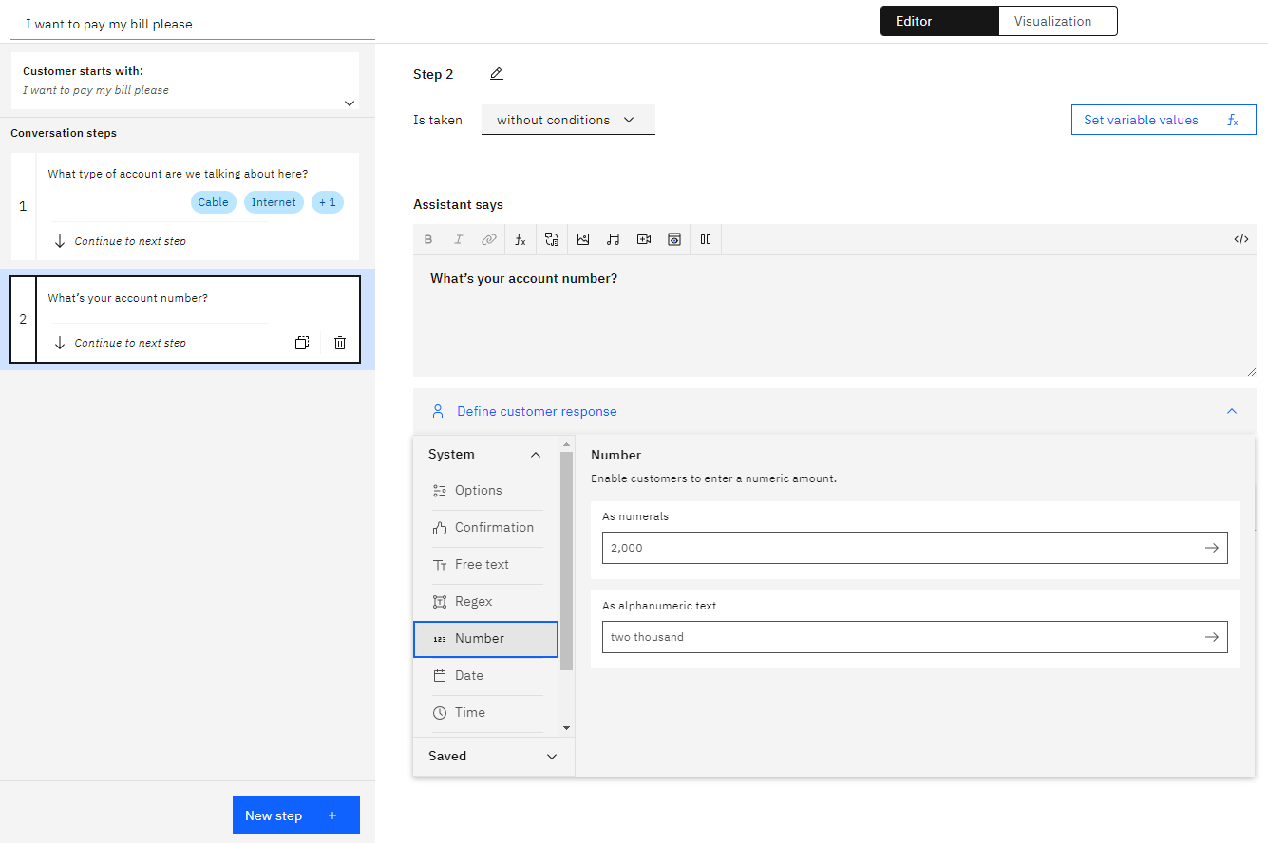
Create Another Clarification Step
7
8

Slide 23
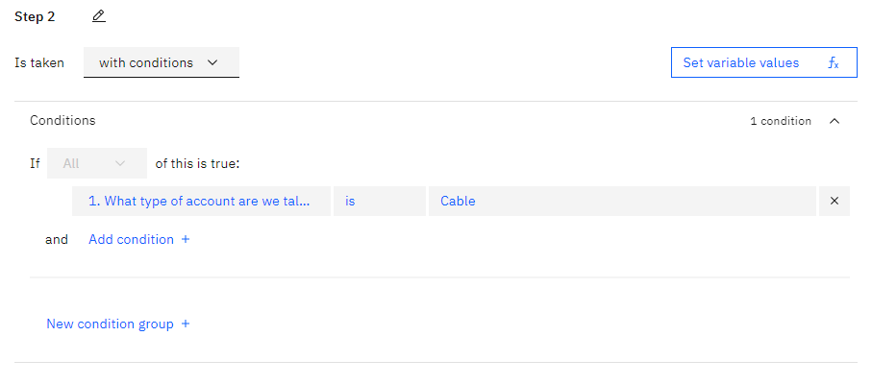
Add Condition
9
10

Slide 24
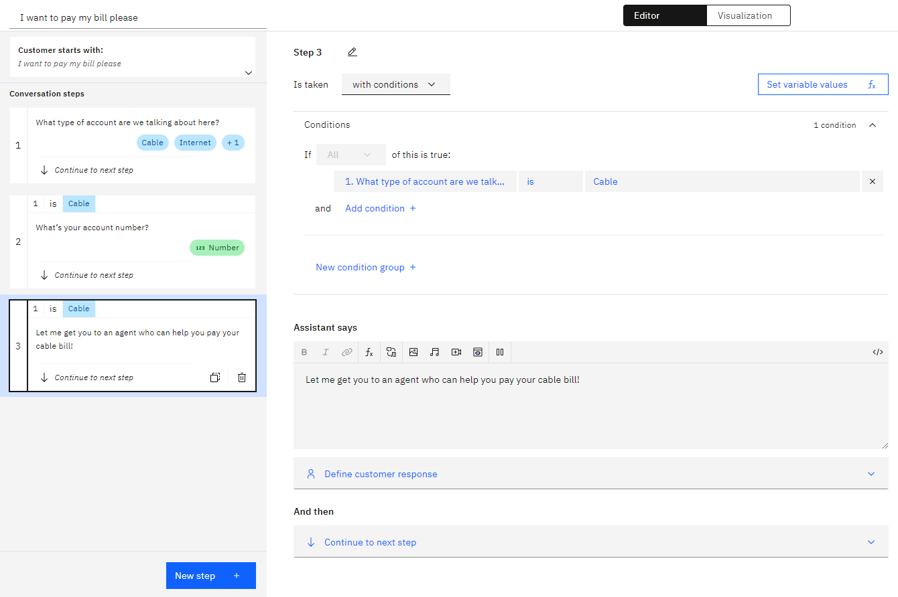
Create an Agent Handoff Step
11
12

Slide 25
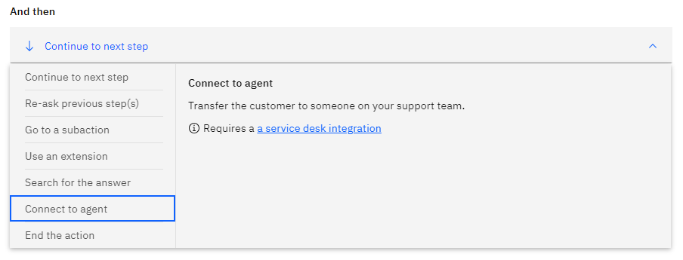
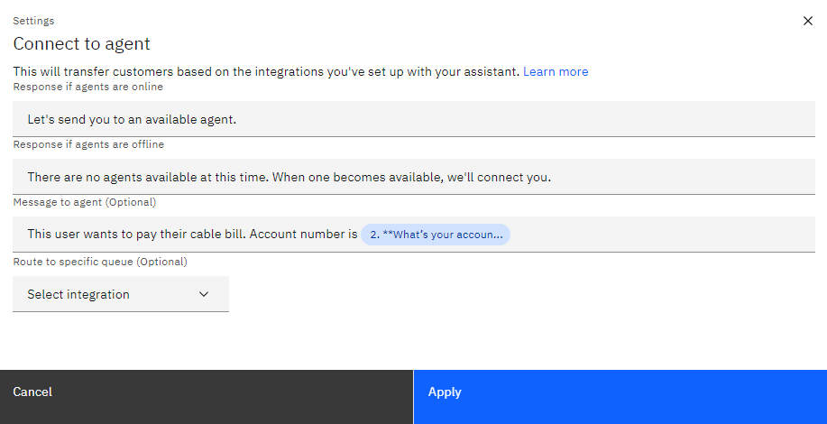
Connect to agent
13

Slide 26
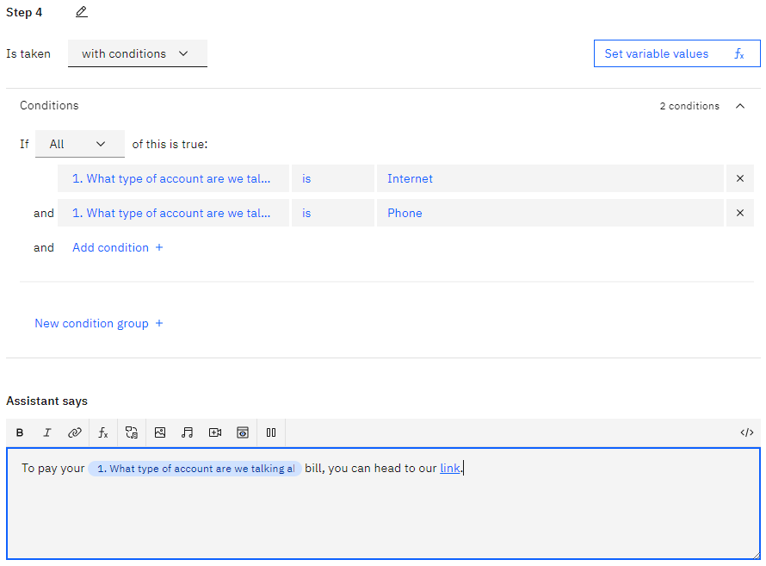
Create Final Response Step
14
15

Slide 27
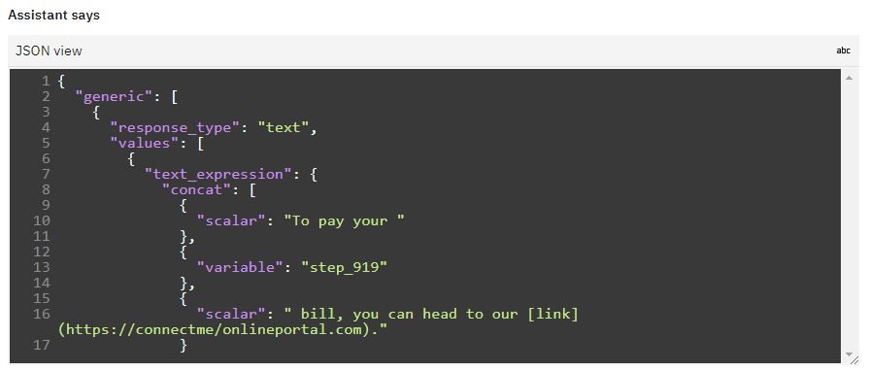
Edit Response in JSON View

Slide 28
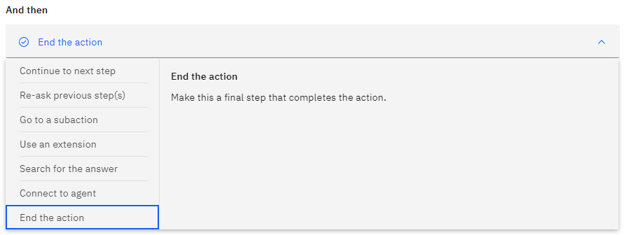
End the Action
16

Slide 29
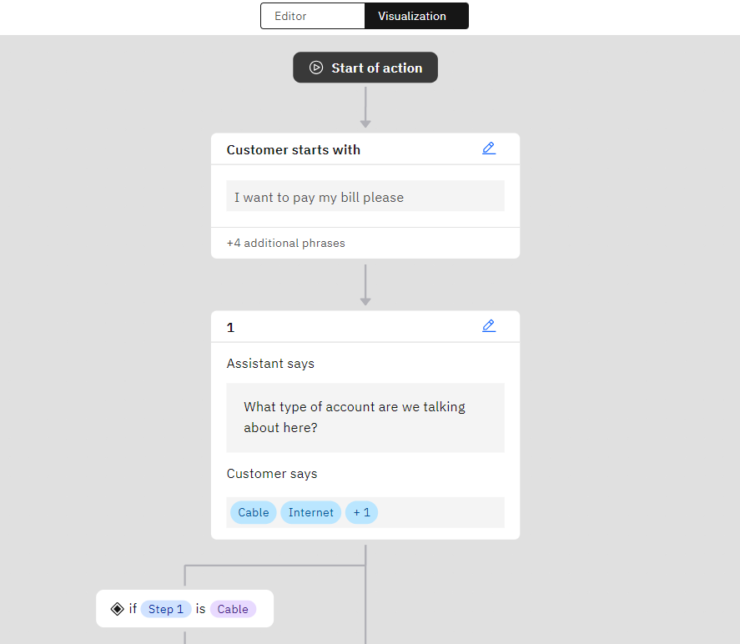
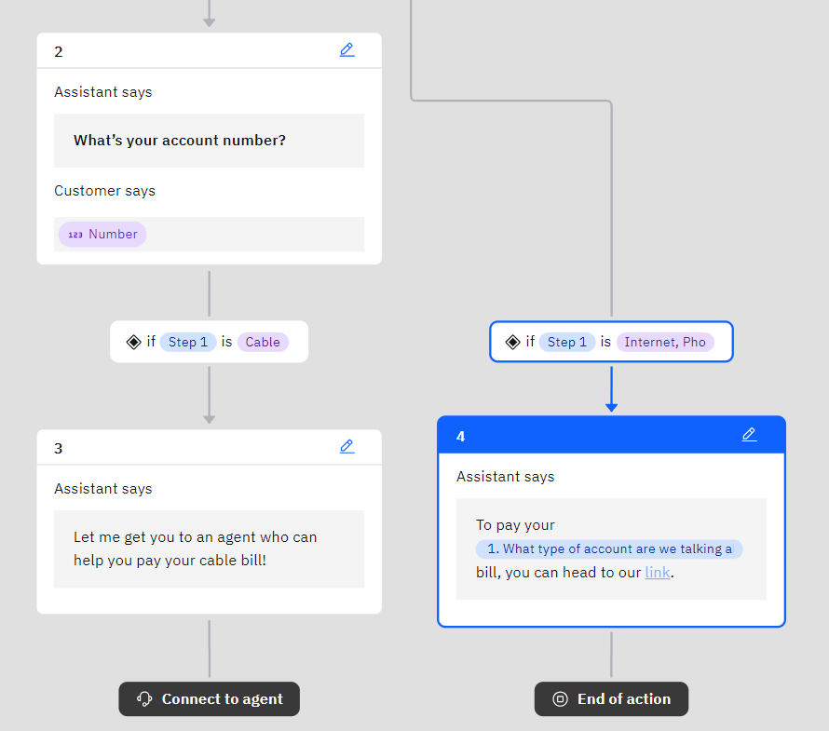
Use Visualization Tool

Slide 30
Refine Your Assistant

Slide 31
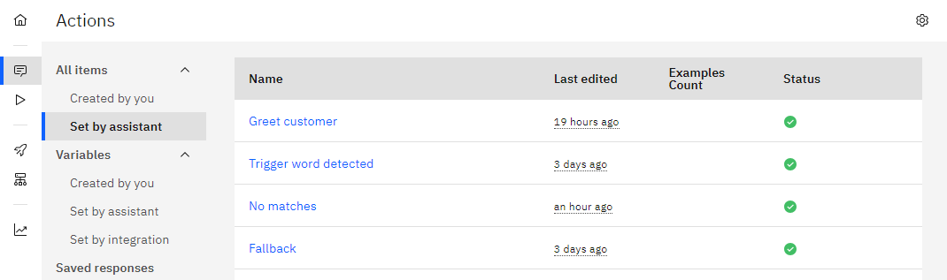
Adjust Default Actions

Slide 32
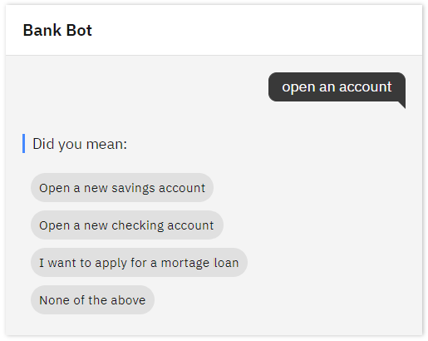
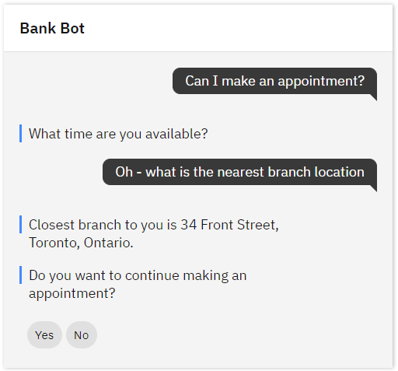
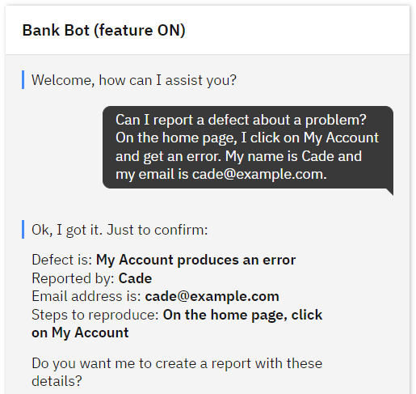
Adjust Global Settings
Clarifying Questions
Show options when multiple actions seem to match what the customer wants
Change Conversation Topics Switch to other actions when customers ask about other topics
Intelligent Information Gathering The assistant retrieves and uses prior inputs to streamline the conversation

Slide 33
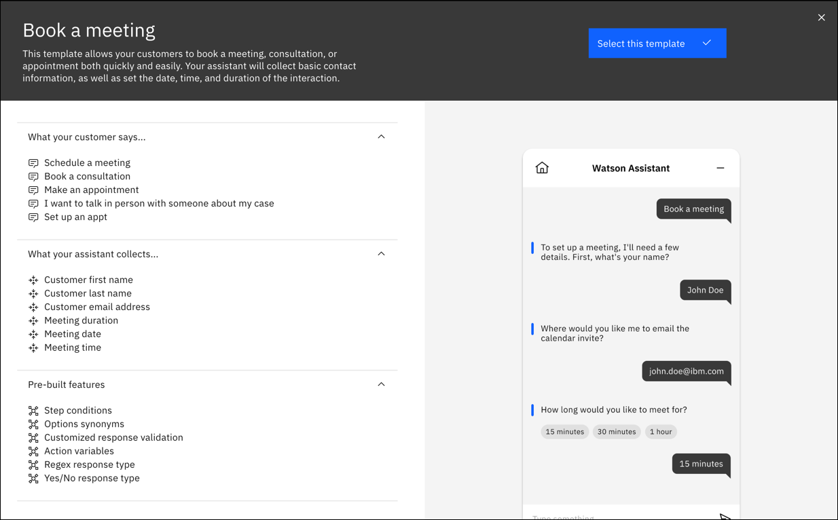
Add More Actions with Templates

Slide 34
Integrate with Watsonx Discovery

Slide 35
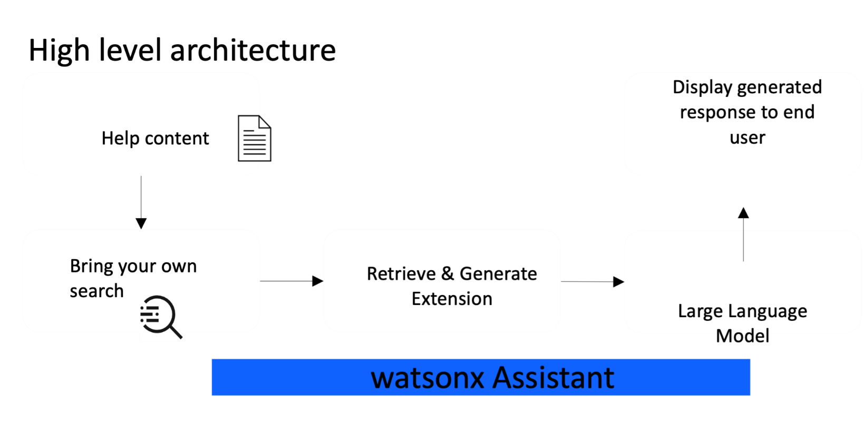
ADD TEXT HERE

Slide 36
ADD TEXT HERE

Slide 37
Integrate with Db2

Slide 38
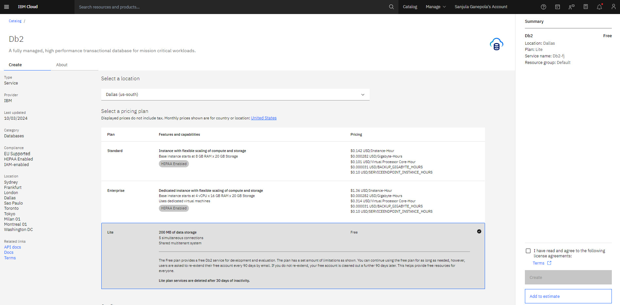
Create Db2 Database in IBM Cloud

Slide 39
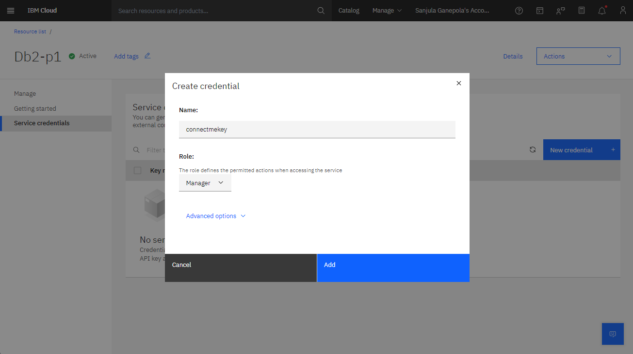
Create Service Credentials
Note the following:
database
hostname
port
username
password

Slide 40
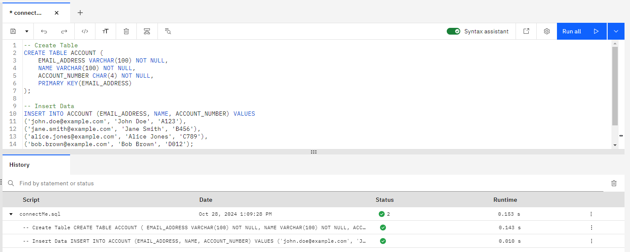
Create Account Table and Insert Data

Slide 41
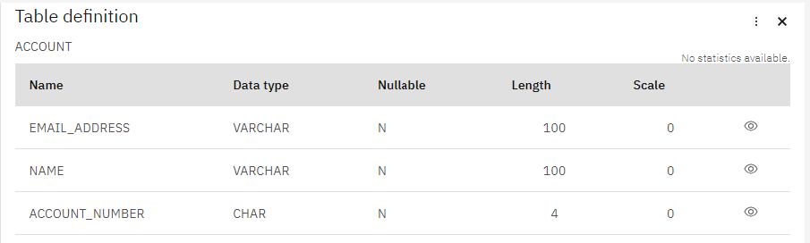
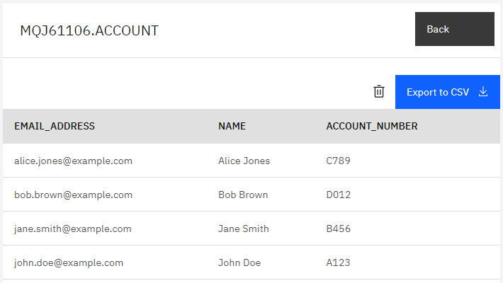
Verify Data

Slide 42
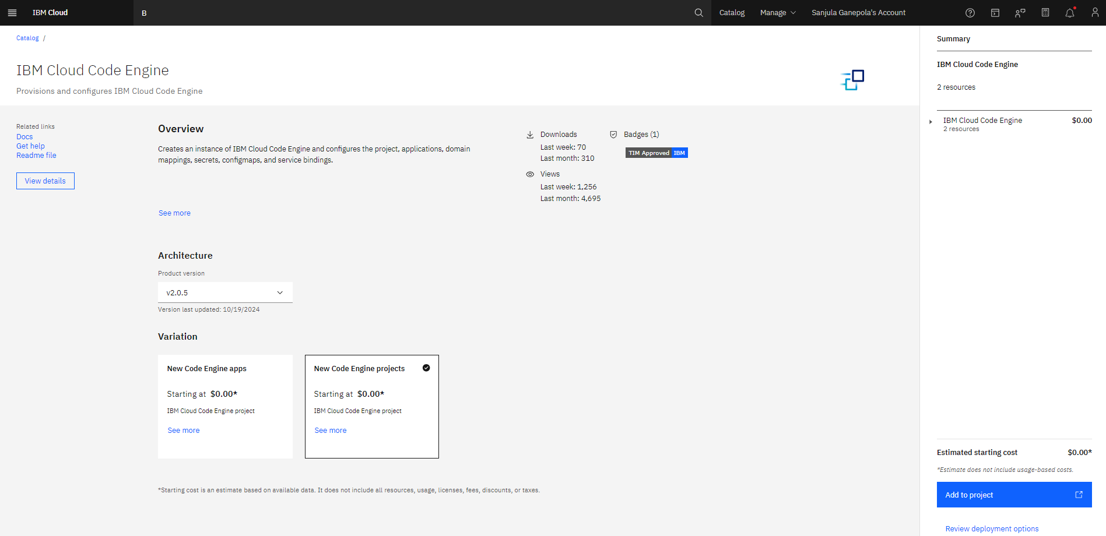
Create IBM Cloud Code Engine Instance

Slide 43
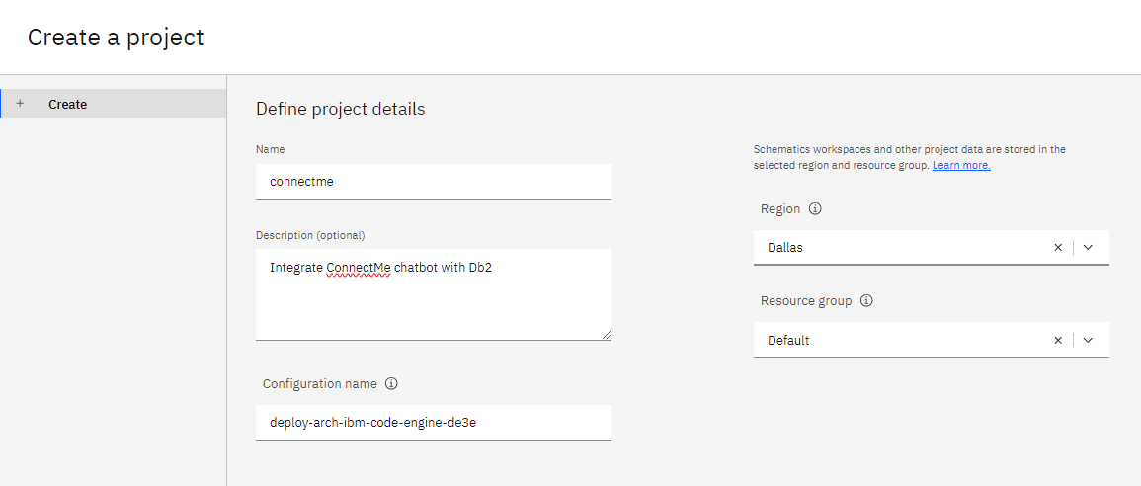
Create a Project

Slide 44
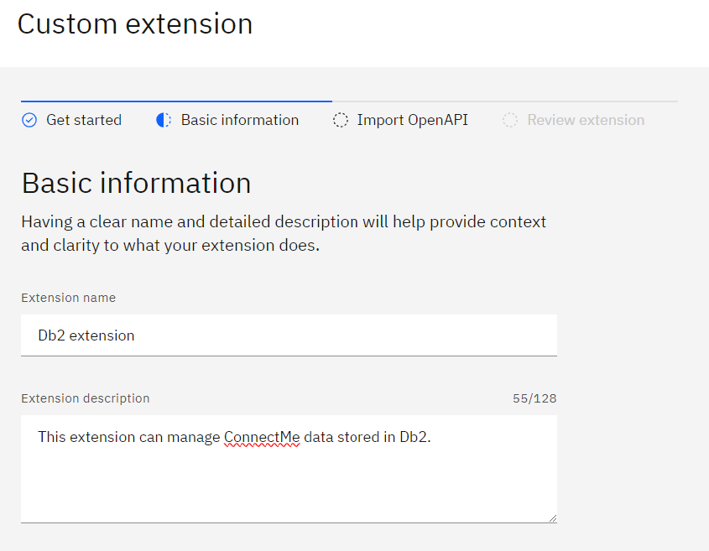
Build Custom Extension

Slide 45
AAAAA

Slide 46
AAAAA

Slide 47
AAAAA

Slide 48
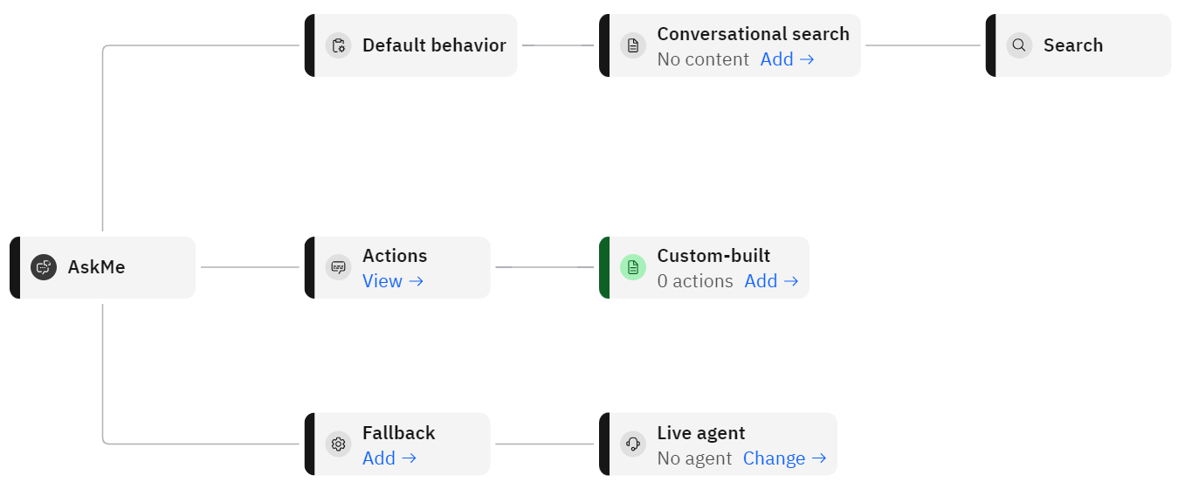
Assistant Architecture

Slide 49
Any Questions?

Slide 50
Important Links
IBM Watsonx Assistant
Documentation https://cloud.ibm.com/docs/watson-assistant
B B

Slide 51

For More Information
Links You Need | Twitter | #Hashtags
IBM i Home Page: https://www.ibm.com/it-infrastructure/power/os/ibm-i (find link to Forrester Study and updated IBM i Strategy Whitepaper) IBM Strategy Whitepaper: https://www.ibm.com/it-infrastructure/us-en/resources/power/i-strategy-roadmap/ IBM Client Success: https://www.ibm.com/it-infrastructure/us-en/resources/power/ibm-i-customer-stories/ Support Life Cycle: https://www.ibm.com/support/lifecycle/ License Topics: https://www-01.ibm.com/support/docview.wss?uid=nas8N1022087 Fortra IBM i Marketplace Survey https://www.fortra.com/resources/guides/ibm-i-marketplace-survey-results | @IBMSystems @COMMONug @IBMChampions @IBMSystemsISVs @IBMiMag @ITJungleNews @SAPonIBMi @SiDforIBMi | #PowerSystems #IBMi #IBMAIX #POWER9 #LinuxonPower #OpenPOWER #HANAonPower #ITinfrastructure #OpenSource #HybridCloud #BigData

